Slide 1

CRISIS MANAGEMENT

Slide 2
Crisis are unexpected events that can cause disruption
Crisis management involves strategies and procedures to handle unexpected events
The objective of this lecture is to understand how crisis management principles apply to ICT and how to effectively respond to ICT crises.

Slide 3
Types of ICT Crises
Cybersecurity Incidents:
  Examples include data breaches and virus
Network Outages and Infrastructure Failures:
Causes may include hardware failures, software glitches, or human errors.
3. Software Bugs and System Vulnerabilities:
Vulnerabilities in software or systems can be exploited by attackers to gain unauthorized access or cause system malfunctions.
4. Data Loss or Corruption:
  Accidental deletion, hardware failures, or malicious activities can lead to the loss or corruption of valuable data.

Slide 4
Prevention and Preparedness
Identify potential crises through risk assessments and scenario planning.
Implement measures to mitigate risks and enhance resilience, such as business continuity planning and cybersecurity measures.
Establish a crisis management team and develop response plans with clear roles and responsibilities.

Slide 5
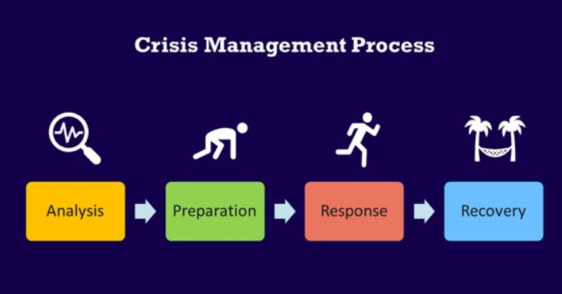
Crisis management process

Slide 6
Crisis Response Strategies
Analysis
  Assess the current situation and understand the nature and severity of the crisis.
  Analyze available data and information to determine the root cause and contributing factors.
Preparation
  Activate the crisis management team and ensure all members understand their roles and responsibilities.
  Review and update crisis management plans and procedures as necessary.
  Prepare communication materials and channels for internal and external stakeholders.
  Ensure availability of necessary resources and support for crisis response efforts.
Response
  Implement the crisis management plan and initiate response actions immediately.
  Communicate transparently and proactively with stakeholders about the situation and response efforts.
  Coordinate response activities across departments and with external partners as needed.
  Take decisive actions to mitigate the impact of the crisis and protect the organization's interests.
Recovery
  Stabilize the situation and restore essential functions and services.
  Conduct a thorough post-incident analysis to identify lessons learned and areas for improvement.
  Update crisis management plans and procedures based on the findings of the analysis to enhance preparedness for future crises.

Slide 7
Case Study: Cybersecurity Breach at TechGuard Inc.
Background: TechGuard Inc. is a leading technology company specializing in cybersecurity solutions. Recently, TechGuard's internal systems were compromised in a sophisticated cyberattack, leading to a data breach and potential exposure of sensitive customer information.
Crisis Management Process:
Analysis:
  Upon discovery of the breach, TechGuard's cybersecurity team immediately assesses the extent of the intrusion and identifies the attacker's tactics,
  They determine that the breach originated from a phishing email that accessed to sensitive data.
Preparation:
  TechGuard activates its crisis management team, comprising cybersecurity experts, IT personnel, legal advisors, and communication specialists.
  The team reviews and updates the company's incident response plan to address the breach, including containment, eradication, and recovery procedures.
  They prepare communication materials for notifying affected customers, regulatory authorities, and the public about the breach and TechGuard's response efforts.

Slide 8
Response:
  TechGuard takes immediate action to contain the breach, including isolating affected systems, disabling compromised accounts, and deploying additional security controls.
  The crisis management team communicates transparently with internal stakeholders, providing regular updates on the situation and response efforts.
Recovery:
  After containing the breach and mitigating immediate risks, TechGuard focuses on restoring affected systems and services.
  They work closely with affected customers to assess the impact of the breach and implement remediation measures, such as credit monitoring and identity theft protection.
  TechGuard conducts a thorough post-incident analysis to identify lessons learned and improve its cybersecurity posture, including enhancing employee training, updating security policies, and implementing additional security measures to prevent future breaches.
Outcome: Despite the initial impact of the cyberattack, TechGuard's swift and coordinated response efforts enable them to contain the breach, minimize the impact on customers, and maintain trust and confidence in their cybersecurity capabilities.

